Slide 1

Applicant Informational Session for 2018 Post PQV Applicants
April 27, 2017

Slide 2







Welcome and Introductions
Janet LaBella Reggie Haley Kris Reinertson
Megan Lacchini Shay Bracey Mark Freedman

Slide 3
Who Should Attend this Webinar?
  Post-PQV Applicants
    Are current recipients of LSC funding;
    Have had an LSC program quality visit since January 1, 2015;
    Have been notified that they will receive the final PQV report by July 3, 2017;
    Are the only applicant for the service area
  Any staff member involved in preparing the application
  Not sure? Send an email to LSCgrants@lsc.gov

Slide 4
Agenda
  Overview of the LSC grants process
  Overview of the Post PQV RFP
Guidance on responding to the Post-PQV Inquiries
Fiscal Application
  Subgrants
  LSC Regulations and Grant Assurances
  Submit questions at any time to AISitems@lsc.gov
  Total estimated duration: 60 minutes

Slide 5
Reminders
  The session will be recorded and posted on the LSC website
  Complete the AIS Evaluation Survey after the conference
  Technical issues or questions during this webinar? Email AISitems@lsc.gov

Slide 6
Overview
Purpose
LSC Evaluation
The Online Application
Key Activities and Deadlines

Slide 7
Purpose of the Competitive Bidding process
Encourage the effective and economical delivery of high quality legal services to eligible clients;
Provide opportunities for qualified attorneys and entities to compete for grants and contracts to deliver legal services to eligible clients;
Encourage ongoing improvement of performance by recipients in providing legal services to eligible clients;
Preserve local control over resource allocation and program priorities; and
Minimize disruptions in the delivery of legal services to eligible clients within a service area during a transition to a new provider.
See 45 C.F.R. § 1634

Slide 8
Evaluations and Awards
LSC Evaluates proposed delivery systems
  LSC Performance Criteria
  ABA Standards for the Provision of Civil Legal Aid
  LSC Regulations
LSC awards funds to applicants that demonstrate the best capacity to deliver effective and efficient high-quality legal services

Slide 9
Application Timeline
 | Final PQV Report Received by: | April 28, 2017 | July 3, 2017
 | Schedule | Schedule B | Schedule C
1 | LSC notifies applicants that they are the only applicant for the service area and are eligible to file the Post-PQV grant application. | May 10, 2017 | May 10, 2017
2 | Online application system opened: | May 15, 2017 | July 7, 2017
3 | Application due: | June 12, 2017 | August 7, 2017
4 | LSC publishes the list of Applicants who filed qualified applications: | October, 2017 | October, 2017
5 | Grant decisions made: | December, 2017 | December, 2017
6 | Grant awards made: | January, 2018 | January, 2018

Slide 10
Fully Automated Application
The Post PQV RFP and grant renewal application are automated.
Responses to all inquiries, charts, and forms are submitted online. Information that is unique to an applicant, such as the organization chart, is uploaded.
Once you login into LSC Grants, you will access the RFP inquiries, charts, and forms from the blue navigational bar along the left side of the application.
The automated application is intuitive and user-friendly.
Email questions pertaining to the automated application to the competitive grants service desk at LSCgrants@lsc.gov.

Slide 11

About the Post-PQV Application
The Post-PQV grant application informs LSC of the progress made in implementing the Tier 1 Recommendations in the program quality visit report.
Post PQV applicants will not respond to the standard RFP Inquiries or the standard renewal inquiries.
  Applicants will:
  Describe actions taken or planned in response to “Tier 1” Recommendations from the final PQV report
  Describe any significant changes or major developments in the delivery system since the PQV ended, and those that are anticipated during the grant year
  LSC reviews the Post-PQV grant application and the final PQV report together

Slide 12
Post PQV Grant Award and Grant Renewal Application Components
1 |  | 2 | 3
Application Requirements |  | Post PQV Grant Award Application | Post PQV Grant Renewal Application
Responses to Tier-1 Recommendations |  | Yes | Yes
Supplementary inquiry on compliance with LSC Regulations |  | Yes | Yes
Subgrant Application |  | Yes | Yes
Fiscal Application and Fiscal Uploads |  | Yes | No
Disclosure on fraud, embezzlement, or theft |  | Yes | Yes
RFP Inquiries Converted to Charts
 | Priorities, Goals, Strategies, and Outcomes | Yes | Yes
 | Outcomes Met for Previous Priorities | Yes | Yes
 | Accomplishments for Clients | Yes | Yes
 | Accomplishments for Clients through PAI | Yes | Yes
 | Involvement with Justice and Advocacy Community | Yes | Yes
 | Accomplishments for Clients with Other Providers | Yes | Yes
 | Needs Assessment – Data Collection Methods | Yes | No
 | Needs Assessment – Data Sources and Tools | Yes | No
 | Intake System Technology | Yes | No
 | Intake Methods | Yes | No
 | LEP Plan and Components | Yes | No
 | Staff Training | Yes | No
 | Legal Work Management | Yes | No
 | Case handling Protocols | Yes | No
 | Case Development Activities | Yes | No
 | Private Attorney Involvement | Yes | No
 | Methods Used to Recruit Private Attorneys | Yes | No
 | Methods Used to Retain Private Attorney Volunteers | Yes | No
 | Methods Used to Promote and Expand Private Attorney Involvement | Yes | No
 | Board Policies and Practices and Frequency of Board Meetings | Yes | No
 | Continuity of Operations Planning | Yes | No
Standard Grant Uploads and Forms
 | Budget, Tech, Governing Body, 990, and Certification Form | Yes | Yes
 | PAI Plan and PAI Expenses | Yes | Yes
 | Organizational Overview and Organization Chart | Yes | Yes
 | Performance Evaluations from non-LSC Funders | Yes | No

Slide 13
New Charts for 2018
(converted from grant application inquiries)
1 | 2 | 3
Description of Chart | Post PQV Grant Award Application | Post PQV Grant Renewal Application
Date of your most recent and next needs assessment | Yes | No
Date of your most recent and next strategic planning process | Yes | No
Outcomes Data (i.e., do you collect outcomes for extended and limited services) | Yes | Yes
Intake (i.e., Do you have a coordinated or centralized intake system) | Yes | Yes
Days and hours of intake by type | Yes | Yes
Bar Admission (i.e., are attorneys admitted to practice in Federal court) | Yes | No
Private Attorney Involvement Activities | Yes | No
Board Committees and Frequency of Meetings | Yes | Yes
Date of most recent and next evaluation of the executive director | Yes | Yes
Evaluations of staff (i.e., are staff evaluated annually, when is the next evaluation) | Yes | No
Decrease in total staff case closures of more than 20% | Yes | Yes
Decrease in total PAI case closures of more than 20% | Yes | Yes

Slide 14
LSC’s Expectations for the Post-PQV RFP

Slide 15
LSC’s Funding Decisions
Based on
Programmatic quality
Appropriate fiscal oversight
Regulatory compliance
Evidenced in
Grant application
Grantee reports to LSC
Visit findings
Other sources (e.g. other funders, websites)

Slide 16
For Grant Applications that Raise Concerns
LSC will request supplemental information for non-responsive or incomplete applications
Capability assessment visit could be required
Special Grant Conditions may be attached
Less than 3-year funding may be awarded *
Service area may be re-competed
*For grant award applicants only

Slide 17
Guidance for Preparing the Post-PQV Proposal or
Post-PQV Grant Renewal

Slide 18
Performance Area 1
Recent and thorough assessment of legal needs
Clear strategies for addressing those needs coupled with projected outcomes that are significant and client centered
Recent or planned strategic planning that involved key stakeholders, and addresses program growth and effective allocation of resources
Procedures for evaluating efficiency and effectiveness of program services

Slide 19
Performance Area 2
Has effective relations with the client community
Demonstrates dignity and sensitivity for clients
Has LEP policy and practice that meets the language needs of the service area
Has intake system that provides broad and timely access and is efficient

Slide 20
Performance Area 3
Criterion 1: Legal Representation
Criterion 2: Private Attorney Involvement
Criterion 3. Other program services to the eligible client population
Criterion 4. Other program activities on behalf of the eligible client population.

Slide 21
Performance Area 4
Effective board governance
Strong leadership
Strong internal operations and administrative systems
Effective financial management
Effective resource development
Effective coordination with other service providers

Slide 22
Guidance for responding to “Tier 1” recommendations based on the Applicant's actions to date

Slide 23
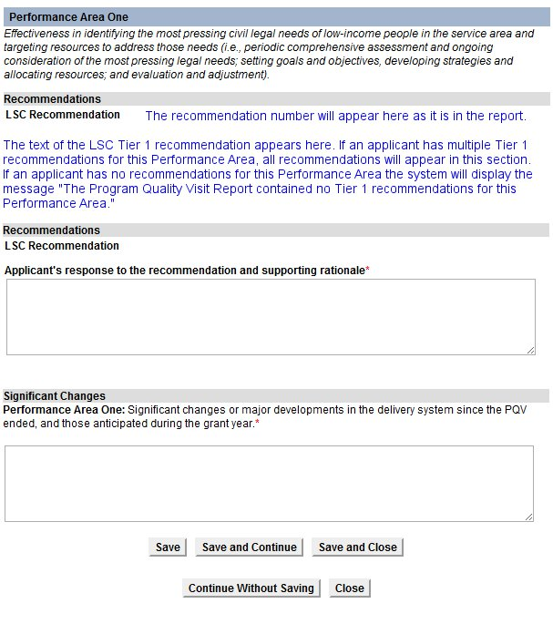
This is the Page used to respond to
Tier-1 Recommendations
Description of the performance area
Recommendation number and the tier-1 recommendation that appears in your final PPQV report
Recommendation
Status
Drop down box where you identify the status of action taken on the tier-1
Text box for your response on the status of the tier -1 recommendation

Slide 24
Guidance on Responding to
Tier 1 Recommendations
Applicant’s action to date:
The LSC recommendation has been implemented.
Describe what was done to make it clear that the recommendation was fully implemented.
Include information describing the impact of having implemented the recommendation and the anticipated outcomes, unless the impact and outcomes are evident.

Slide 25
Guidance on Responding to
Tier 1 Recommendations
Applicant’s action to date:
The LSC recommendation is being implemented.
Describe any aspect of the recommendation that has been completed
Describe the aspect(s) that remain to be completed, and why they have not been completed
Include details, such as: a timeline including the tasks to be completed, staff involved, the expected benefits and outcomes, etc.

Slide 26
Guidance on Responding to
Tier 1 Recommendations
Applicant’s action to date:
The recommendation is being implemented in part or with certain modifications.
Describe the course of action taken and the reasons for it
Explain why the recommendation is not being implemented fully
Give the reasons why the partial implementation or modification better suits the needs of the applicant and/or supports more efficient or effective service delivery
Explain why full implementation is not possible or practical

Slide 27
Guidance on Responding to
Tier 1 Recommendations
Applicant’s action to date:
The LSC recommendation is being considered.
Explain what is under consideration and why
Explain what factors are influencing the decision
If resources are at issue, discuss the costs and any less resource-intensive ways to accomplish the goals of the recommendation
Explain when the decision is expected to be made
Identify the key persons in the decision making process

Slide 28
Guidance on Responding to
Tier 1 Recommendations
Applicant’s action to date:
The recommendation is not being implemented
Explain, in detail, why it is not being implemented
If the reason is lack of resources at this time, support the conclusion with an explanation of the financial implication and the reason that following the recommendation is not possible or feasible.
If the applicant does not agree with the recommendation, support that conclusion with a thorough explanation of why the recommendation is not, in the light of all the circumstances, in the best interests of the client community and/or the program and would not lead to more efficient and/or effective service delivery. Provide any alternative methods for achieving the desired outcome that is being employed by applicant.

Slide 29
Using the Post-PQV Form

Slide 30
Using the Post-PQV Application
Use the Post-PQV Application to
  Respond to Tier 1 recommendations
  Describe changes to the delivery system
  Respond to the Supplemental Inquiry
  Access Charts
Notes:
Show attendees how to use the copy feature.

Slide 31
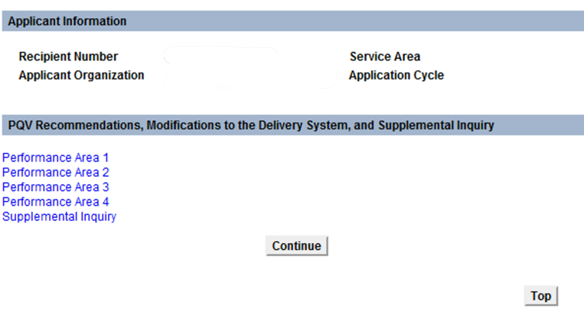
Navigating the Automated Post PQV Application
Links to the four performance areas, which includes the related chart and forms.

Slide 32
This is the Page used to respond to
Tier-1 Recommendations
Description of the performance area
Recommendation number and the tier-1 recommendation that appears in your final PPQV report
Recommendation
Status
Drop down box where you identify the status of action taken on the tier-1
Text box for your response on the status of the tier -1 recommendation

Slide 33
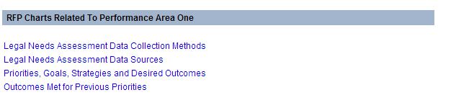
Navigating the Automated RFP Application
A link is provided for each RFP chart.
Click on the link and the chart page will open.
When finished, click “Save and Return” at the bottom of the chart page. The system will redirect back to the criterion page.

Slide 35
Priorities, Goals, Strategies, and Outcomes

Slide 36
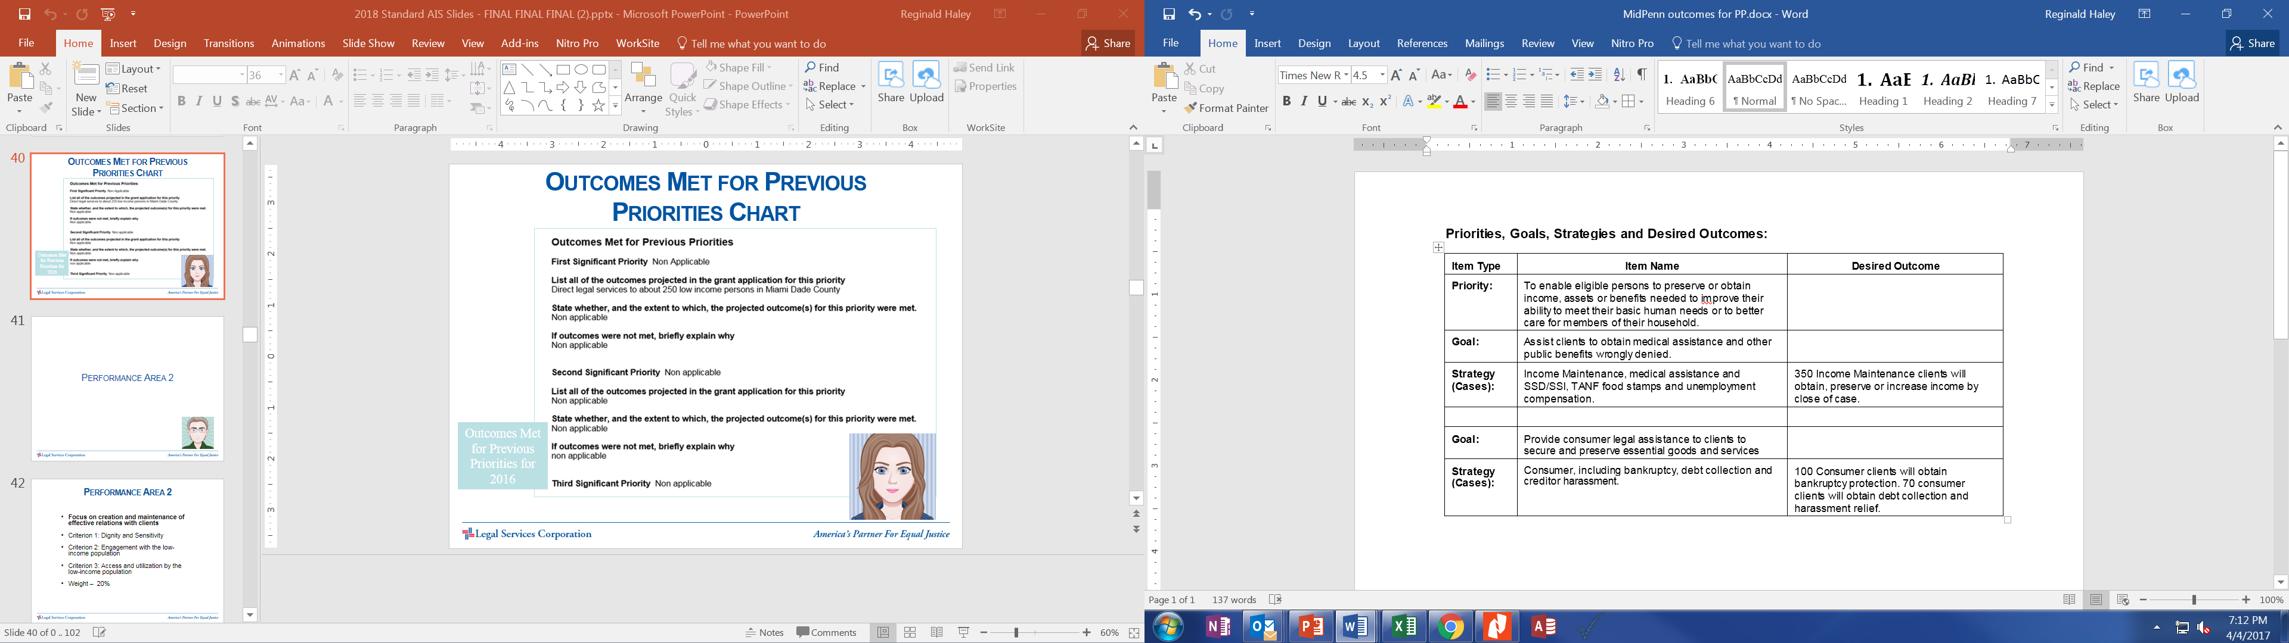
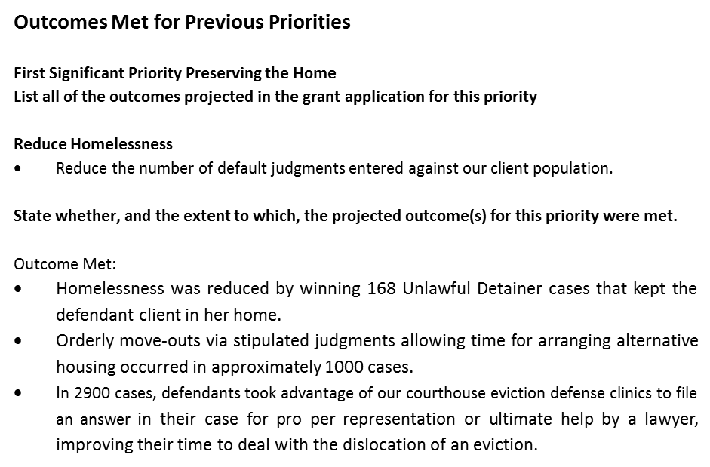
Priorities, Goals, Strategies, and Desired Outcomes Charts
Priorities, Goals, Strategies, and Desired Outcomes for 2017
Outcomes Met for Previous Priorities for 2016
Notes:
Moderator: What suggestions do you have for applicants in completing the Priorities, Goals, Strategies and Desired Outcomes charts?
All applicants, including those in renewal, should understand the difference between the two charts in this section. The first chart requires applicants to provide Priorities, Goals, Strategies, and Desired Outcomes for 2016. The second chart requires applicants to report on whether its projected outcomes for 2015 were met. One looks forward and one looks back.
Applicants should consider previous outcomes to help guide them in determining realistic outcomes for 2016. For each priority, applicants will likely have more than one goal, strategy, and desired outcome. LSC is interested in knowing how the applicant plans to address its priorities (which were determined through the needs assessment); what goals it has set forth to address those priorities (which are clearly-defined and client-centered); how it plans to meet those goals (through a number of strategies); and what its intended result is (which are the desired outcomes). This is really the meat and potatoes for applicants holding themselves accountable to their boards, to funders, and to the client community.
The box to the left shows an example of a single priority “Maintaining the stock of decent affordable housing” with a couple of goals and several strategies under each goal. This is an example of the looking forward chart.
Moderator: What is the relationship between the “Priorities, Goals, Strategies and Desired Outcomes” chart and the “Outcomes Met for Previous Priorities” chart.
Good question. The Priorities, Goals, Strategies, and Desired Outcomes presented in last year’s application, or renewal, are used to complete the chart you see on the right on this slide. It requires applicants to let LSC know if its desired outcomes from 2015 were met. If the program had stated in last year’s application that it would represent 50 private tenant and 10 public housing tenant families in retaining their residences through cases undertaken in 2015, LSC wants to know whether the program actually met that outcome. And in the event that the program has not met its outcomes, LSC wants to know why.

Slide 37
Case Service Outcomes
Applicants are required to report outcomes only for case services – limited and extended
Case services outcomes are the tangible results of case services such as improvements in clients’ housing conditions, income, and, employment.
Case service outcomes for clients should be expressed in concrete, measurable terms (i.e., a specified number of clients are provided with specified benefits).

Slide 38
Examples of outcome descriptions that are acceptable
Housing conditions will be improved for 200 clients
The criminal records of 150 clients will be expunged
200 families will have court orders that protect a family member from domestic violence
100 foreclosures will be prevented
200 evictions will be averted
200 clients will obtain or have SSI/SSD benefits increased
Medicaid benefits will be preserved and/or increased for 300 clients

Slide 39
Examples of unacceptable desired outcomes for cases and the reasons they are not acceptable.
Examples of unacceptable case outcomes | The reason why these outcomes are not acceptable
o Develop and launch three medical legal partnerships | o Does not describe results of case services
o Provide all domestic violence shelters with information about how the legal aid program can help | o Does not describe case services. Also, does not specify concrete, tangible benefits in measurable terms
o Reduce the percentage of homelessness in the client community | o Not specific enough. What are the specific case outcomes that will reduce homelessness? What will be the specific percentage reduction? How will it be calculated?
o Serve client community in family preservation issues | o Does not specify concrete, tangible benefits in measurable terms
o Provide high quality legal representation to the client community | o Does not specify concrete, tangible benefits in measurable terms

Slide 40
Using the Online
Application System at lscgrants.lsc.gov

Slide 41
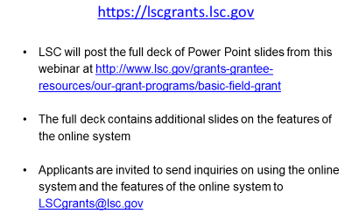
LSC’s Online Application System

Slide 42






Questions?
  Send questions through the AISitems@lsc.gov
  The session will be recorded and will be posted on LSC Grants
  Complete the AIS Evaluation Survey after the conference
  Questions after the webinar? Email lscgrants@lsc.gov

