Slide 1
Applicant Informational Session for 2019 Standard Grant Applicants
April 25, 2018
Notes:
SLIDE

Slide 2
Welcome and Introductions
Ed Caspar Reggie Haley Kris Reinertson
James Scruggs Ronké Hughes Lewis Creekmore Evora Thomas
Office of Program Performance (OPP)
Notes:
Hello, on behalf of the Legal Services Corporation I would like to welcome you to the 21st Annual Applicant Informational Session. This is Kris Reinertson, I am with the Office of Program Performance and I will be moderating today’s presentation. On this year’s panel, we have:
• Ed Caspar, Reginald Haley, Evora Thomas, Lewis Creekmore, Ronké Hughes and James Scruggs from the Office of Program Performance,
SLIDE

Slide 3
Welcome and Introductions (Cont.)
Megan Lacchini Shanda Gottlieb
Office of Compliance and Enforcement (OCE)
Notes:
• Megan Lacchini and Shanda Gottlieb from the Office of Compliance and Enforcement
SLIDE

Slide 4
Who Should Attend this Webinar?
New and returning applicants for basic field grants
Any staff member involved in preparing the application
Programs applying for a 2019 Grant Award that did not have an LSC Program Quality Visit (PQV) in 2016, 2017 or 2018.
Programs that had a PQV in 2016 or 2017, but will not receive a final report by July 2, 2018
This presentation is NOT for any program that had a PQV in 2015, 2016 or 2017 and has received a final report
Not sure? Send an email to lscgrants@lsc.gov
Notes:
• Let’s take a moment to talk about who our audience should be.
• This presentation is for applicants who are filing the standard grant proposal for 2019 funding
• That includes all current recipients that did not have a program quality visit in the past two years and all new applicants
• If you are unsure whether you will be using the Standard RFP or the Post PQV RFP, please email LSCgrants@lsc.gov
• We will NOT be covering materials for other grant programs such as Technology Innitiative Grant and Pro Bono Innovation Fund.
SLIDE

Slide 5
Agenda
Overview of the LSC grants process
LSC’s expectations for responses to the RFP
Performance Area Highlights
Fiscal Application
Subgrants
LSC Regulations and Grant Terms and Conditions
Submit questions at any time
Send questions to AISitems@lsc.gov
Total estimated duration: 90 minutes
Notes:
Here is today’s agenda. We will…
provide an overview of the LSC Grant Award process
discuss LSC’s expectations for responding to the RFP Inquiries and Charts,
discuss the application process under each of the four Performance Areas
Discuss the Fiscal Application
Discuss Subgrants of LSC funds
Discuss LSC regulations and Grant Assurances; and
We expect the conference to continue approximately 90 minutes.
Please send questions to AISitems@lsc.gov.
NEXT SLIDE

Slide 6
Reminders
Recommended: have 2019 Standard RFP Narrative Instruction available
http://www.lsc.gov/grants-grantee-resources/our-grant-programs/basic-field-grant
The session will be recorded and will be posted at https://www.lsc.gov/grants-grantee-resources/our-grant-programs/basic-field-grant/how-apply
Complete the AIS Evaluation Survey after the conference
Send questions to AISitems@lsc.gov
Notes:
Just a few reminders before we begin:
We will respond to your questions throughout the webinar.
We recommend that you have a copy of the 2019 Request for Proposals Narrative Instruction available during the session. You can download the RFP as a pdf file. The URL is right there for you.
This Webinar is being recorded, and the video will be available on the LSC and LSC Grants websites within a couple of days for you or other staff members to refer back to.
At the end of the session, you will receive an email from me with a link to an evaluation survey. Please take a moment to complete the evaluation so that we can determine how this conference was helpful and make changes for future years.
We will answer questions following the discussion of the application process, Performance Areas Highlights, and LSC Regulations and Grant Terms and Conditions
Email us at AISitems@lsc.gov if you have any questions for the panel or experience technical difficulties during the conference.
With that, let’s get started.
SLIDE

Slide 7
Overview: Application Process, Materials, Resources and Key Deadlines
Notes:
SLIDE

Slide 8
LSC Grant Award Process
Encourage the effective and economical delivery of high quality legal services to eligible clients;
Provide opportunities for qualified attorneys and entities to compete for grants to deliver legal services to eligible clients;
Encourage ongoing improvement of performance by recipients in providing legal services to eligible clients;
Preserve local control over resource allocation and program priorities; and
Minimize disruptions in the delivery of legal services to eligible clients within a service area during a transition to a new provider.
See 45 C.F.R. § 1634
Notes:
The LSC grants process was mandated by Congress in 1996, and is governed by the LSC regulation on competitive bidding at 45 C.F.R. Part 1634. The regulation outlines several purposes of the LSC grants process, which you can see on your screen right now, or you can refer to 45 CFR Part 1634.
SLIDE

Slide 9
Evaluation and Awards
LSC evaluates proposed delivery systems
Selection Criteria at 45 CFR Part 1634
LSC Performance Criteria
ABA Standards for the Provision of Civil Legal Aid
LSC awards funds to applicants that demonstrate the best capacity to deliver effective and efficient high-quality legal services
Notes:
LSC evaluates each applicant’s grant proposal based on the Selection Criteria at 45 CFR Part 1634, the LSC Performance Criteria, and the ABA Standards.
LSC awards funds to those applicants that demonstrate the best capacity to deliver effective and efficient high-quality legal services to eligible clients.
SLIDE

Slide 10
Eligible Applicants
Current recipients
Other non-profit organizations that have as a purpose the furnishing of legal assistance to eligible clients
Private attorneys, groups of attorneys or law firms
State or local governments
Substate regional planning and coordination agencies
See 45 C.F.R. § 1634.5
Notes:
Here is the list of entities eligible to apply include:
(1) Current recipients;
(2) Other non-profit organizations that have as a purpose the furnishing of legal assistance to eligible clients;
(3) Private attorneys, groups of attorneys or law firms
(4) State or local governments; and
(5) Substate regional planning and coordination agencies
SLIDE

Slide 11
Application Timeline
Date | Event
May 4, 2018 | Submit the Notice of Intent to Compete
June 4, 2018 | Submit the Standard Application
October, 2018 | LSC publishes the list of qualified applicants
December, 2018 | Grant decisions published
January, 2019 | Grant awards made
Notes:
The deadline for filing the Notice of Intent to Compete is May 4, 2018
The deadline for filing the grant application is June 4, 2018, and the entire application must be complete before it can be submitted.
LSC will publish the list of applicants who filed a qualified grant application in October.
Grant decisions will be published in December and grant awards will be made in January of 2019.
SLIDE

Slide 12
Grant Writing and LSC’s Grant Award Decisions
Notes:
Thanks, Reggie. Let me address now some grant writing best practices and what goes into LSC’s grant award decisions.
SLIDE

Slide 13
Grant-Writing Best Practices
Answer the questions asked
Be specific in your responses
Avoid vague, incomplete, or exaggerated answers
Don’t bury responses in unnecessary detail
Be accurate
Make sure responses are consistent throughout
Proofread for grammar, spelling and punctuation
Notes:
First off, it is important to answer the questions asked
If we ask you to state the date when you conducted your most recent needs assessment, give us the date. Remember to answer all subparts. For example, if we ask about evaluations of your delivery system and any resulting changes, make sure you discuss both the evaluations and the changes.
Next, be specific in your responses
If we ask how you evaluate the effectiveness of limited services, and any notable changes made as a result of any evaluation; then we want to know the frequency of your evaluations, who did the evaluations, the methods used, and what changes were made, if any.
Avoid vague, incomplete, or exaggerated answers
When we ask you to describe how the effectiveness of your legal representation has been evaluated, responding merely that it is routinely evaluated or even stating that it is annually evaluated without any details does not describe the evaluation process or to what extent you found your legal representation to be effective. If your program does not evaluate the effectiveness of legal representation, then simply say so.
Do not bury responses in unnecessary detail
For example, if asked to state whether you have a technology use policy, and to briefly discuss the policy, don’t bury the discussion of the policy in a description of unrelated technology issues such as the purchase of new laptops.
Be accurate
We do not read the RFPs in a vacuum; rather we look at Case Service Reports, PQV Reports, Reports from the Office of Compliance and Enforcement, and Grant Activity Reports. While it is appropriate to put your best foot forward, excessive embellishment can hurt an applicant’s credibility.
Make sure responses are consistent throughout
While we appreciate that different sections of the application might be completed by different staff with appropriate expertise, one person should read the completed application before submission to assure consistency in your answers.
Proofread for grammar, spelling and punctuation
Again, one person, perhaps not even one of the drafters, should be responsible for a final edit. Improper grammar or spelling is distracting to the substance of the application, and it can negatively impact the assessment of the program’s overall quality.
SLIDE

Slide 14
LSC’s Funding Decisions
Based on
Programmatic quality
Appropriate fiscal oversight
Regulatory compliance
Evidenced in
Grant application
Grantee reports to LSC
Visit findings
Other sources (e.g. other funders, websites)
Notes:
Turning to LSC’s Funding Decisions,
LSC grant decisions are based on Programmatic quality, appropriate fiscal oversight, and regulatory compliance.
We assesses these areas based on all current information available -- This includes grant activity data, program visit reports, a program’s implementation of any special grant conditions, audit reports, evaluation reports from other funders, and of course all components of the grant application
Based on our consideration of all of this information, the President of the Legal Services Corporation may award a grant for up to 3 years. In some instances, a grant term of less than 3 years, and sometimes special grant conditions may be appropriate.
SLIDE

Slide 15
For Grant Applications that Raise Concerns
LSC will request supplemental information for non-responsive or incomplete applications
Capability assessment visit could be required
Special Grant Conditions may be attached
Less than 3-year funding may be awarded
Service area may be re-competed
Funding may be denied
Notes:
So, let me address grant applications that raise concerns. Here’s what can happen:
• If an answer is insufficient or the applicant failed to respond to an inquiry, LSC will request supplemental information
• If the concerns relate to potential weakness in programmatic quality, LSC may conduct an onsite capability assessment, attach Special Grant Conditions, or award less than 3-year funding
• If the concerns demonstrate serious deficiencies in the applicant’s capacity to provide legal services consistent with LSC LSC Regulations, requirements, or Performance Criteria, LSC might not fund the grant application and instead may re-open the service area for competition.
SLIDE

Slide 16
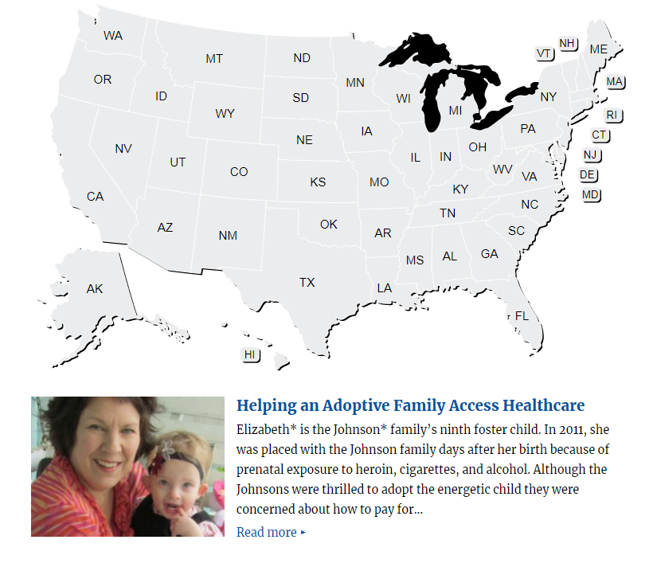
Client Success Stories
Minimum number of stories to submit:
One story per Congressional District
Or, for service area with only one Congressional District: 2 client success stories
Notes:
This year, we are also asking that you submit Client Success Stories. These stories are useful for meetings with members of Congress, and will also be used on LSC’s website and in other published materials. A client stories template will be available in LSC Grants and you are to include your stories with any accompanying pictures or videos in the template to be uploaded under the Uploads section.
The minimum number of stories to submit is one client success story per Congressional District in your service area. For example, if there are 4 Congressional Districts within your service area, you are required to submit 4 client success stories, one client success story from each Congressional District. If your service area contains only one Congressional District, then please provide two stories at a minimum stories.
Please do not submit stories for Agricultural Workers at this time.
Photos or videos are encouraged. Photos should be of good quality but under 15 megabytes per image. Videos should be uploaded to a service such as Youtube and you can provide the link to the video in the client stories template.
Stories may be derived from your “accomplishments for clients” and from your “involvement with the justice and advocacy community” under Performance Area 3, but must follow Client Success Stories template provided in LSC Grants.
SLIDE

Slide 17
Responding to the RFP Inquiries
Notes:
Okay, Let’s talk about the RFP inquiries
SLIDE

Slide 18
Responding to RFP Inquiries
The RFP Inquiries follow the format and content of the LSC Performance Criteria.
New applicants that have not previously received a grant from LSC must respond to each RFP inquiry, unless otherwise indicated.
Applicants that do not yet have a system, strategy, procedure, policy, or activity in place at the time the grant proposal is submitted should describe their capacity and plans to put them in place.
Notes:
The RFP Inquiries are based on the LSC Performance Criteria.
Applicants must respond to each RFP inquiry.
If the applicant does not have a particular system, strategy, procedure, policy, task, or activity in place at the time the grant proposal is submitted to LSC, the grant proposal must still demonstrate the applicant’s capacity and plans for adopting these requirements.
SLIDE

Slide 19
The Four Performance Areas
Performance Area | Percentage Weight | Number of RFP Inquiries * | Number of RFP Charts
1 | 18% | 9 | 7
2 | 20% | 10 | 5
3 | 35% | 19 | 12
4 | 27% | 18 | 6
* some inquiries have sub-parts
This excludes the Fiscal Application Inquiries
Notes:
Each performance area is weighted. On the screen you see the weights for each of the Performance Areas, as well as how many RFP Inquiries and RFP Charts are in each performance area. Keep these weights in mind as you respond to the RFP inquiries.
SLIDE

Slide 20
Navigating the Automated RFP
Notes:
Applicants will prepare their grant proposals using the LSC online application.
To prepare the grant proposal, applicants will log in at https://lscgrants.lsc.gov to access the grant application.
On the blue navigation bar on the left-hand side of the screen, you will find the link to all components of the grant application including the link to the RFP Inquiries and Charts.
Clicking that link will open a page that lists all of the Performance Areas and Criteria. If you follow any of the links, the page will open for that Performance Criteria. Let’s suppose we click on Performance Area 1, Criterion 2 now.
SLIDE

Slide 21
Navigating the Automated RFP
Full text of each RFP Inquiry is displayed on screen, followed by a text box.
Consider drafting responses using a word processor and copying responses into the text boxes.
Notes:
That will open up a page for that criterion. It will include the full text of each RFP Inquiry that’s associated with it. You can type into the text boxes, but you may want to type out the responses in a word processor beforehand, and then just paste it into the form.
SLIDE

Slide 22
Navigating the Automated RFP
A link is provided for each RFP chart.
Click on the link and the chart page will open.
When finished, click “Save and Return” at the bottom of the chart page. The system will redirect back to the criterion page.
Notes:
On that same page, you’ll also see the RFP Charts that are associated with the criterion. RFP Charts are additional data forms that are also a part of the RFP.
On the criterion page, a link is provided for each RFP Chart. If you click on the link, the chart will open. You will complete the chart, and you’ll find a “Save and Return” button at the bottom of the page. That will bring you back to the criterion page.
A full list of all the RFP charts are in the RFP Narrative Instruction.
SLIDE

Slide 23
Applying for Multiple Service Areas
You may apply for more than one service area. For example, you may apply for basic field, agricultural worker and/or Native American service areas.
You should respond to the RFP Inquiries for each service area (e.g. agricultural worker or Native American) by specifically describing the service delivery system for that service area.
If the response is the same for two or more service areas
Enter a response for the service area receiving the largest grant
For the additional service area(s), applicant may state:
“Applicant services and activities are the same for this service area as for the service area receiving the largest grant.” When using this option, make sure the services and activities are really the same. Any differences should be indicated.
Notes:
For those of you applying for multiple service areas, such as migrant or Native American, there are a couple of things to keep in mind.
First, applicants are expected to specifically describe the service delivery system for that service area.
Second, for a few inquiries, such as those pertaining to board governance, the response may be the same for each of the service areas. In those instances, applicants may state that the response is the same as that provided in the application for the service area receiving the larger grant
SLIDE

Slide 24
Using the Online Application System at lscgrants.lsc.gov

Slide 25
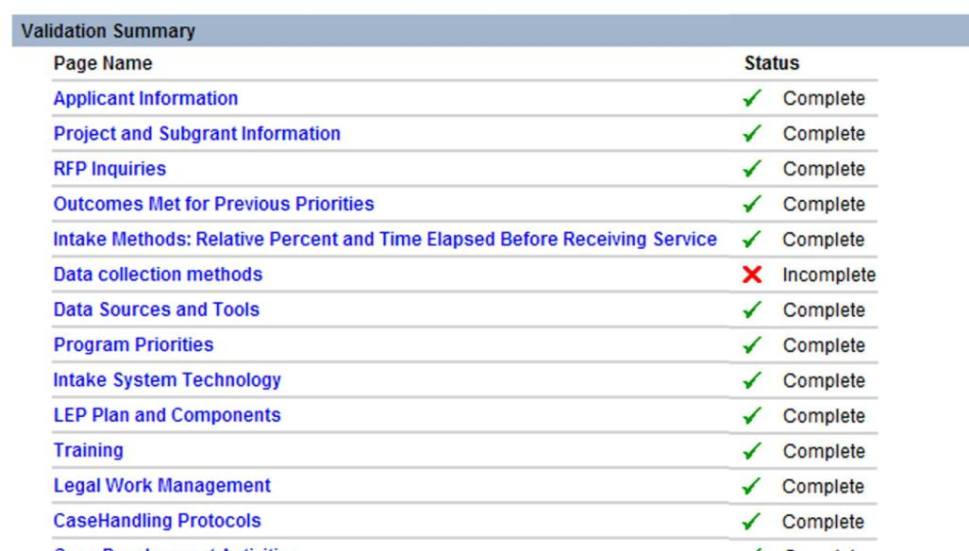
Why Can’t I Submit??
Red X’s indicate forms that are not yet complete

Slide 26
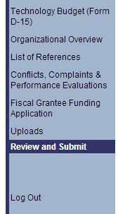
The Review and Submit Page
Use the Review and Submit page to see detailed notes

Slide 27
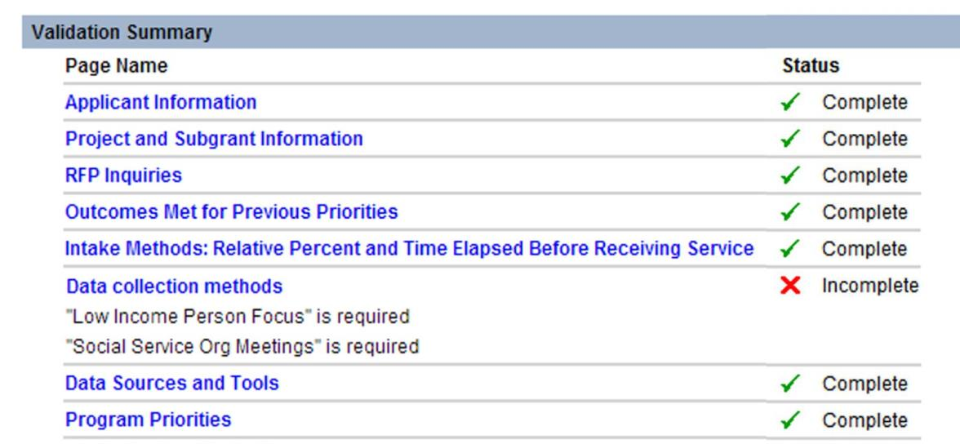
The Review and Submit Page
Review and Submit provides detailed notes on what’s missing

Slide 28
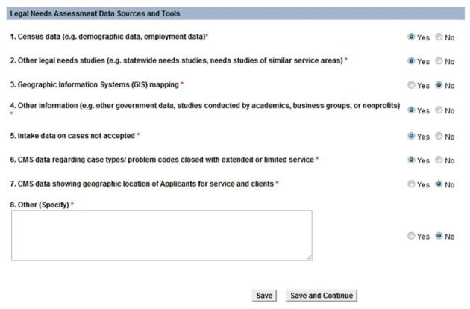
Linked Forms
For applicants applying to more than one service area
Some RFP Charts and Forms are “linked” across service areas
Any information entered in a “linked” form in one application is automatically transferred to all other service areas for which the applicant is applying

Slide 29
The Copy Feature
For applicants applying to more than one service area
Copies application data from one service area to another
Instructions for using the copy feature are on the “copy task page” in LSC grants
Use carefully to avoid overwriting data unintentionally
Uploads not copied

Slide 30
The Copy Feature (cont.)

Slide 31
The Copy Feature (cont.)

Slide 32
The Copy Feature (cont.)
Review all copied information to ensure accuracy

Slide 33
Pre-population
Allows users to save time by importing previous information
Review all information to ensure accuracy

Slide 34
Pre-population (cont.)
 | Current Recipients | New Applicants
Intake System Technology | most recent grant application | -
Projected Expenses (D-12) | most recent grant application | -
Projected Revenue (D-14) | most recent grant application | -
Board Members (F-2) | most recent grant application, or 1607 Report | NIC
Technology (K) | most recent grant application | -
Review all information to ensure accuracy

Slide 35
Technical Support
Email:
techsupport@lsc.gov

Slide 36
Q&A
Overview of the LSC grants process
LSC’s expectations for responses to the RFP
To ask a question during the webinar, email AISinquiries@lsc.gov

Slide 37
Performance Area 1
Effectiveness in identifying the most pressing civil legal needs of low-income people in the service area and targeting resources to address those needs
Notes:
SLIDE: Performance Area One (Title Page)
Moderator: Now, let’s begin our discussion on the application process, what LSC looks for in your grant application, and answer any questions you may have. We’ll start with James Scruggs and Performance Area One which is “Effectiveness in identifying the most pressing civil legal needs of low-income people in the service area and targeting resources to address those needs”
NEXT SLIDE: Performance Area 1 Overview
Moderator: What does Performance Area One cover and why is it important in LSC’s assessment of programmatic quality?

Slide 38
Performance Area 1 - Overview
Criterion 1: Legal Needs Assessment
Criterion 2: Setting Priorities, Goals, Strategies, and Outcomes
Criterion 3 & 4: Implementation, Evaluation and Adjustment
Performance Area 1 includes 11 inquiries and 7 charts and is 18% weight
Notes:
Applicants should think of Performance Area One as a roadmap to their program and should be able to demonstrate how they’ve conducted a thorough assessment of the most pressing legal needs in their service area AND how they plan to allocate resources to meet those needs.
Performance Area One has four criteria and this year applicants are required to respond to 11 inquiries and 7 charts:
Criterion 1 covers Legal Needs Assessment
Criterion 2 covers Setting Priorities, Goals, Strategies and Outcomes
Criterion 3 & 4 covers Implementation, Evaluation, and Adjustment
Moderator: What is the relationship of Performance Area One with the other performance areas?
Applicants should look at Performance Area One as the first impression LSC has about their programs. It sets the framework for how an applicant provides client-centered, effective, and efficient legal services. Performance Area One not only lays out the plan for the program’s legal work (which is Performance Area Three), but it also lays out plans for effective intake (which is Performance Area Two), and the program’s strategic plan, which should include goals for program leadership and administration (which are covered in Performance Area Four).
NEXT SLIDE: Needs Assessment

Slide 39
Needs Assessment
Recent: Date of last needs assessment.
Periodic: How often do you conduct needs assessments?
Ongoing: What approaches are taken to determine needs between assessments?
Comprehensive: Does the assessment incorporate data, use emerging technology, and include input from community groups?
Notes:
Moderator: What is most important for applicants to focus on in describing their needs assessment?
In responding to the inquiries and charts under this section, applicants should be mindful of these four elements in describing their most recent legal needs assessment.
Is the last needs assessment RECENT? LSC wants to know the date of the program’s most recent comprehensive legal needs assessment. When was it conducted?
Does the program conduct PERIODIC assessments? LSC also wants to know how often programs are conducting comprehensive legal needs assessments. Is it every year? Every 3 years? Or, every 5 years?
Does the program conduct ONGOING assessments? LSC wants to know what programs are doing between comprehensive needs assessments to keep abreast of the emerging needs in the service area. For example, is there a growing population with new legal needs? Maybe disaster has struck? How is the program identifying and assessing emerging legal needs?
Was the last needs assessment COMPREHENSIVE? LSC is interested in knowing what approaches the program has considered to carry out its most recent legal needs assessment. This could include getting the views of the client community; getting the views of people that work with and know the problems of the client community, analyzing data, and using available or emerging technology, such as GIS mapping.
NOTE: If an applicant has NOT conducted a recent comprehensive legal needs assessment, applicants should explain the reasons why and describe what approaches have been taken in the interim to determine the most pressing legal needs in the service area. In addition, applicants should note when it plans to conduct a new comprehensive needs assessment.

Slide 40
Needs Assessment Data Chart
PAST: Enter the date when you conducted the most recent comprehensive assessment of civil legal needs facing the low-income population.
FUTURE: Enter the date when you plan to conduct the next comprehensive assessment.
Notes:
Applicants are required to complete three charts relating to their most recent legal needs assessment. The first chart requires applicants to enter the specific dates for when they conducted the most recent legal needs assessment and for when they intend to conduct their next comprehensive needs assessment.
NEXT SLIDE: Needs Assessment Data Chart

Slide 41
Needs Assessment Data Chart
Methods used by program in its most recent legal needs assessment
Data and Tools used by program in its most recent legal needs assessment
Notes:
The other two charts required under Needs Assessment include the data collection methods and sources and tools used. These charts let LSC know what methods were used for data collection, what stakeholders were consulted as part of the assessment process, and what data the program relied on to determine the most pressing needs within the service area.
Applicants should also be aware that in addition to discussing their needs assessment process and completing the charts on data collection and sources used, this year’s RFP also requires them to upload the needs assessment report that they submitted to their boards to determine program priorities.
NEXT SLIDE: Priorities, Goals, Strategies & Desired Outcomes

Slide 42
Priorities, Goals, Strategies and Desired Outcomes
Clear, well-defined priorities and goals
Strategies for achieving goals
Desired outcomes for current year (2018)
Notes:
Moderator: How is the needs assessment process integrated with setting priorities, measuring outcomes and evaluating program effectiveness?
Everything a program does flows from the needs assessment. A program’s priorities are typically developed from the needs assessment, which enables it to allocate resources to meet the most pressing needs within its service area. LSC is interested in the applicant’s priorities and goals, the strategies for achieving the goals, and the desired outcomes for 2018.
Basically, we’re trying to understand if the applicant’s priorities, goals, strategies, and desired outcomes are significant and appropriate given the most pressing needs in the client community. Are they practical and achievable given the program’s resources? Are they realistic?
LSC is also interested in whether the program has achieved the desired outcomes from its last grant application (and that applies to renewal and competition). In other words, is the program meeting its goals?
The information applicants provide in this section is important because it helps LSC make the connection between funding and the impact of legal services, which helps in making make the case for continued funding of civil legal aid for low-income people.
NEXT SLIDE: Understanding Priorities, Goals, Strategies and Desired Outcomes

Slide 43
Understanding Priorities, Goals, Strategies and Desired Outcomes
Priorities
A simple statement of the work to be undertaken.
“Preservation of the Home.”
Goals
A broad statement of results intended to achieve.
“Maintain low-income tenants in habitable, decent, safe, affordable housing.”
Notes:
Moderator: Do you have any tips for applicants to assist with filling out the Priorities, Goals and Desired Outcomes chart?
Yes, these next two slides define and give examples of what priorities, goals, strategies, and desired outcomes are. The definitions on these next couple of slides use “housing” as a common thread in discussing an applicant’s priorities, goals, strategies, and desired outcomes.
PRIORITIES are a simple statement of the work to be undertaken. An example of a priority is preservation of the home.
GOALS are broad statements of the results that applicants intend to achieve. An example of a goal is: Maintain low-income tenants in habitable, decent, safe, affordable housing.
NEXT SLIDE: Understanding Priorities, Goals, Strategies and Desired Outcomes

Slide 44
Understanding Priorities, Goals, Strategies and Desired Outcomes
Strategies
Activities to pursue to achieve the goal.
Case strategy: “Legal Representation in Eviction cases.”
Other Service strategy: “Community education sessions on tenants’ rights.”
Desired Outcomes
Tangible results achieved for clients from the legal services provided.
“Prevent 300 families from being evicted.”
Notes:
STRATEGIES are the activities the applicant will pursue to achieve the goal.
An example of a case strategy is Legal representation in eviction cases; and
An example of a non-case strategy is a Community Education session on tenant’s rights.
Don’t be confused about the strategies here and your strategic planning process. These strategies are what guides your legal work, based on the needs assessment. They are only a part of your strategic plan, which we will cover in a moment.
OUTCOMES are the tangible results achieved for clients from the legal services provided that affect their health, living conditions, income, domestic stability, assets and/or employment status. An example is to Prevent evictions for families in 300 cases.
NEXT SLIDE: Priorities, Goals, Strategies, and Desired Outcomes Charts

Slide 45
Priorities, Goals, Strategies, and Desired Outcomes Chart
Priorities, Goals, Strategies, and Desired Outcomes for 2018
Notes:
Moderator: What suggestions do you have for applicants in completing the Priorities, Goals, Strategies and Desired Outcomes charts?
This chart requires applicants to provide their priorities, goals, strategies, and desired outcomes for 2018. The chart looks forward to what the program expects to achieve. The example in this slide uses “Income Maintenance” as a priority, with a couple of goals and strategies under each goal.
Applicants should consider previous outcomes to help guide them in determining realistic outcomes for 2018. For each priority, applicants will likely have more than one goal, strategy, and desired outcome.
LSC is interested in knowing:
how the applicant plans to address its priorities (which were determined through the needs assessment);
what goals it has set forth to address those priorities (which are clearly-defined and client-centered);
how it plans to meet those goals (through various strategies); and what its intended result is (which are the desired outcomes).
This is the meat and potatoes for applicants holding themselves accountable to their boards, to funders, and to the client community.
NEXT SLIDE: Outcomes Data Chart

Slide 46
Outcomes Data Chart
Do you collect outcomes achieved for clients for all extended services cases?
Do you collect outcomes achieved for clients for all limited services cases?
Notes:
As with last year’s RFP, applicants must complete a chart that asks these two simple questions:
Do you collect outcomes achieved for clients for all extended services cases? And
Do you collect outcomes achieved for clients for all limited services cases?
This year LSC has added some additional inquiries under Criterion 2, regarding outcomes in extended and limited services cases. Applicants must discuss how they assess outcomes for both limited and extended services cases, and how they use that data for advocacy strategy. Applicants must also discuss the methods that they use to collect outcomes data for both extended and limited services cases.
NEXT SLIDE: Implementation, Evaluation, and Adjustment

Slide 47
Implementation, Evaluation, and Adjustment
Regular evaluation of the effectiveness of legal services delivery system
Comparison of results achieved to the outcomes originally intended
Changes in goals and strategies to ensure outcomes are achieved (or to meet emerging needs)
Regular review of strategic plan
Notes:
LSC is interested in knowing whether the program regularly evaluates the effectiveness of its delivery system by comparing the results achieved with the goals, strategies, and outcomes that were originally intended AND whether the program makes appropriate changes in its goals and strategies to ensure that intended outcomes are achieved.
LSC wants to know what approaches the applicant has taken to evaluate the effectiveness of its work and what adjustments have been made to ensure outcomes are met or to meet any emerging needs. Does the program regularly review its strategic plan? Are the staff and board utilizing the strategic plan?
NEXT SLIDE: Strategic Planning

Slide 48
Strategic Planning
Planning process incorporates priorities, goals, strategies and desired outcomes
Current (Date of Strategic Plan)
Staff and board were involved in the planning process
Evaluation of efficiency and effectiveness of service delivery system
Evaluation of strategies that ensure growth, stability, and viability of program (staffing, offices, technology, resource development, organizational structure, etc.)
Notes:
Moderator: What is the importance of strategic planning?
Strategic planning is important for programs to help them properly allocate resources and guide to their work. LSC is interested in knowing details about a program’s most recent strategic planning process. For example, when did it occur, who was involved (staff, board, community members), and how it was conducted.
LSC is also interested in knowing whether a program’s strategic plan sets out specific measurable goals and whether it helps to insure the short- and long-term sustainability of the program. For example, does the strategic plan address areas outside of the legal work (like staffing, technology, resource development, organizational structure, and finances)?
LSC is also interested in whether a program’s strategic plan includes timelines and identifies specific people or groups responsible for accomplishing goals.
NEXT SLIDE: Strategic Planning Process Chart

Slide 49
Strategic Planning Process Chart
Enter the date the most recent strategic plan was adopted by the board of directors.
Enter the date when you plan to conduct the next strategic planning process.
Enter the time range of the strategic plan.
Notes:
Like last year, applicants will need to complete the Strategic Planning Process Chart. With this chart, LSC wants to know when you conducted your most recent strategic planning process.
Applicants will need to enter the date when the most recent strategic plan was adopted by the board and the date when you plan to conduct the next strategic planning process.
In addition, applicants will be asked to enter the time range of their most recent strategic planning process. When did it begin and end?
This year’s RFP also requires applicants to include their most recent strategic plan as part of the application uploads, in addition to completing the strategic planning chart.
In addition, two new questions concerning strategic planning have been added to inquiry 4, criterion 1. Applicants with current plans will need to discuss their progress in achieving their strategic plan’s goals. Applicants with newly implemented strategic plans will need to discuss how they plan to measure progress. Applicants with strategic plans that are more than five years old will also have to discuss their plans for starting a new strategic planning process, including the anticipated start date.
NEXT SLIDE: Outcomes Met for Previous Priorities Chart

Slide 50
Outcomes Met for Previous Priorities Chart
Outcomes Met for Previous Priorities
First Significant Priority Preserving the Home
List all of the outcomes projected in the grant application for this priority
Reduce Homelessness
Reduce the number of default judgments entered against our client population.
State whether, and the extent to which, the projected outcome(s) for this priority were met.
Outcome Met:
Homelessness was reduced by winning 168 Unlawful Detainer cases that kept the defendant client in her home.
Orderly move-outs via stipulated judgments allowing time for arranging alternative housing occurred in approximately 1000 cases.
In 2900 cases, defendants took advantage of our courthouse eviction defense clinics to file an answer in their case for pro per representation or ultimate help by a lawyer, improving their time to deal with the dislocation of an eviction.
Outcomes Met for Previous Priorities for 2017
Notes:
• LSC is interested in knowing whether a program has met the outcomes completed in its goals the prior year.
• The Priorities, Goals, Strategies, and Desired Outcomes presented in last year’s application, or renewal, are used to complete the chart you see here. It requires applicants to let LSC know if its desired outcomes from 2017 were met.
If the program had stated in last year’s application that it would represent 50 private tenant and 10 public housing tenant families in retaining their residences through cases undertaken in 2017, LSC wants to know whether the program met its proposed outcomes. And, if the program did not meet its outcomes, LSC wants to know why.
Moderator: Thanks for those tips and insights.
I see the time keeper is signaling us to move on to Performance Area Two, which centers on Access and Intake.
Performance Area Two – moderator inquiries

Slide 51
Performance Area 2
Effectiveness in engaging and serving the low-income population throughout the service area
Notes:
Moderator – Please provide an overview of Performance Area 2
*CLICK*

Slide 52
Performance Area 2
Focuses on creation and maintenance of effective relations with clients
Criterion 1: Dignity and Sensitivity
Criterion 2: Engagement with the low-income population
Criterion 3: Access and utilization by the low-income population
Weight – 20%
Notes:
As many of you know, PA 2 sets forth the core values and tenets for creating and maintaining effective relations with clients. The way a program treats clients provides important insights into the relationship the organization hopes to build with the community, and the methods chosen demonstrate the commitment to that community.
Inquiries in this portion of the RFP focus on:
How the applicant engages and serves the target population, specifically exploring whether intake is efficient and conducted in a way that affirms the clients’ dignity.
Whether services provided are culturally and linguistically sensitive.
Whether the approach to client services is shaped by the population’s specific needs.
And the overall accessibility and utilization of the applicant’s services.
This portion of the application is worth 20% of the total score, and it has been revised since the last grant cycle. There are now seven (7) inquiries and seven (7) charts. I will draw your attention to a few and provide some information about how best to address them.
*CLICK*

Slide 53
Performance Area 2
Fosters Engagement
Tailored
Ongoing Evaluation
Effective Intake Systems
Streamlined
Skilled Staff
Flexible & Accessible
Notes:
(The moderator will trigger each trait to drop into the slide as it is discussed)
The Performance Criteria provide indicators of a successful intake system which are reinforced in the ABA Standards for the Provision of Civil Legal Aid. To offer some additional insight into what LSC is looking for, I would like to highlight some qualities of an effective intake system:
The system should foster engagement with the communities its serves. It should serve as a conduit for the public to reach the program and seek assistance. It should not be used to limit contact but to facilitate interactions between the program and the public.
The system should be tailored to meet the communities’ needs, and should be structured to complement the services that the program offers. It should be crafted in a way that includes and considers feedback from potential clients, community partners, and key stakeholders.
The system’s process should be streamlined for both potential clients and staff. From the potential client’s perspective, the process should flow seamlessly and contain few steps. For staff, the system should integrated into office workflow so that seams and barriers are either removed or minimized.
The intake system should be flexible and accessible: flexible in that it can adapt to evolving client needs, and accessible in that it provides multiple points of entry and accommodates those who traditionally face barriers to service.
Its staff are trained, knowledgeable, and competent. They should have be knowledgeable about program services, substantive law, and relevant technology; and skilled at conducting effective interviews and interacting with the client community in a culturally sensitive way.
And finally, the system itself should be examined for effectiveness on an ongoing basis.
*CLICK*

Slide 54
Performance Area 2
Criterion 1 . Dignity and sensitivity.
System Overview
Fully describe your intake system
Tell us about triage
Referrals – incoming and outgoing
Staffing
Function, not just title
Address day-to-day and global oversight
Training
Discuss training and resources
Evaluation
Discuss all methods -- internal and external
Anything new and different in the last two (2) years
Notes:
Moderator – Criterion 1 centers around dignity and sensitivity. What exemplifies dignity and sensitivity in an intake system?
A system that is client-centered is one that really exemplifies those attributes.
Moderator – Can you explore that a little more? What does client-centered mean and why is it important in thinking about intake systems?
The essence of dignity and sensitivity is an intake system that treats clients with respect and establishes a relationship of trust and confidence in the organization, its staff, and the assistance it provides. Client-centered also clear, easy-to-navigate processes. The community should know how your system works. No one on the outside should have to guess about how to request assistance. Information about intake should be easy to find and easy to comprehend. Using the system should require as little effort as possible from prospective clients. It can be a complex system behind the scenes, but the public should not have to be concerned about the inner-workings.
Intake is normally the first contact a client has with the provider. No one wants to feel lost in a maze, so that introduction needs to occur in the least burdensome way possible.
The inquiries associated with Criterion 1 allow LSC to get a sense of how the program approaches intake and access.
This section has changed since the last RFP. The questions are pretty straightforward, but I’d like to draw your attention to a few key items:
(Items reveal on click)
In the first inquiry, RFP asks you to describe your intake system, its modes of operation and any pertinent policies, how the system includes triage, how referrals are handled, and policies for emergency cases. We are looking for a clear, well developed picture of how the intake system functions, including any differences by office or unit.
In the second inquiry, LSC is looking for detailed information about how intake functions are staffed. In responding to this inquiry, listing job titles alone is not sufficient. It is important to describe how each role actually functions in the system.
In the third inquiry in this section, LSC wants to know how intake staff are trained during the onboarding process and beyond. Be specific.
And, finally, the last inquiry asks about intake system evaluation. Evaluation is a critical part of assessing any systems. LSC recognizes that evaluation methods differ and that evaluations can come in different shapes and sizes. For example, an program can examine the entire system of access or just a part of that system. Therefore, there is no single way to answer this inquiry. LSC is looking for information about evaluations conducted internally and by external groups, like other funders, for example. Also, the final subpart asks applicants to identify any significant changes to the intake system in the last two years. We understand that from time to time programs make adjustments to different parts of the intake system. This may be a change in staffing, workflow, or technology used, as a few examples.
*CLICK*

Slide 55
Performance Area 2
Criterion 1 . Dignity and sensitivity.
RFP Charts
Intake
Intake Policies or Procedures
Intake Evaluation
Days and Hours of Intake by Type
Intake System Technology
Intake Methods: Percent & Time Elapsed Before Service
Notes:
There are now six (6) charts in the RFP associated with PA 2, Criterion 1. The first asks two questions about the whether the intake system is coordinated or centralized and whether the office handles intake separately by office or unit. These are simple Yes/No questions.
*CLICK*

Slide 56
Performance Area 2
Focuses on written procedures
Notes:
The next chart is new and focuses on whether the program has written procedures for intake. It will require applicants to answer Yes/No about written procedures for different modes of intake and then give the date of the last revision.
*CLICK*

Slide 57
Performance Area 2
Notes:
Here are the next two charts. The one on the top is new and asks for a little more detail about any evaluation(s) of the intake system.
The one on the bottom is self-explanatory seeks detail about availability of various modes of intake and the levels of utilization.
*CLICK*

Slide 58
Performance Area 2
Intake System Technology
1 | How many phone numbers do you publish for intake in your service area(s)?
 | a. Can calls to an intake number be answered at more than one location?
2 | What is the maximum number of calls your phone system can receive at the same time?
3 | Does your phone system have the capacity for voice mail for intake calls?
4 | Does your phone system have the capacity for automated attendant technology for intake?
5 | Does your phone system have automatic call distribution?
 | a. If so, can callers self-direct their call?
 | b. If callers can self-direct, can they self-select to leave a message?
6 | Does your system offer callers the choice to receive a callback?
 | a. If yes, does your system return the call automatically?
7 | Does your phone system include computer telephony integration?
8 | Does your system include an interactive voice response feature?
9 | Does your system have call routing by language, substantive and/or geographic area?
10 | Does your system have the ability to serve persons with speaking or hearing disabilities through access to TTY or relay service or other mechanism (e.g.; email or text messaging)?
11 | Does your system have the capacity to review wait times in queue, dropped calls?
12 | Does your system have the ability to provide recorded information to callers while waiting or after hours?
13 | Does your program provide an online intake option for prospective clients to apply for services?
 | a. If yes, is the data electronically transferred into your CMS?
 | b. If yes, are you using an A2J interview?
Notes:
The Intake System Technology chart is next and is also self-explanatory.
*CLICK*

Slide 59
Performance Area 2
How long does it take?
Speaks to an Intake Worker
Has a substantive interview
Receives counsel and advice
Receives limited action and/or extended rep
Receives notice of acceptance for extended rep or evaluation
Notes:
LSC is also interested in the time it takes a prospective client to navigate the applicant’s intake system. Information related to this inquiry is captured in the final chart in PA 2 Criterion 1 – Intake Methods: Relative Percent of each Method and Time Elapsed Before Receiving Service chart. In this chart, applicants are asked to specify the amount of time elapsed between initial contact and each step in the intake process. There are many factors that can influence elapsed time between initial contact and service so there is no formula or “right answer.” LSC is mindful that each program needs to be responsive to the community in which it is situated, and as a result, there may be variance in the amount if time it takes to move through a system based on intake mode. However, in every instance, service providers should seek to minimize wait times and streamline processes to provide a better experience for prospective clients.
The chart asks for information about intake conducted via five (5) different methods and the response should be given in minutes, hours, days, or weeks, as appropriate.
If you pursue intake in a method that is not included in the listed categories, you have an opportunity to describe it and provide respond to the prompts.
*CLICK*

Slide 60
Performance Area 2
Criterion 2. Engagement with the low-income population &
Criterion 3. Access and utilization by the low-income population
Outreach
Describe activities in the last 24 months
Describe planned activities for the next 12 months
Provide information about how activities are developed and targeted
Describe efforts to engage with community group and/or other service providers
Notes:
The RFP then moves into the Performance Criteria on engagement with the low-income population and Access and utilization by the low-income population. Here LSC is looking to get a sense about the applicant’s approach to outreach. Outreach activities are a critical part of an effective legal services provider. At a minimum, they serve as a regular reminder to the community of the provider’s presence and the services available. Beyond that outreach can and should be a core part of the service delivery to the community. These activities should aid the program in accomplishing its goals.
There are three (3) inquiries and one (1) chart related to Criterion 2 and 3. Again, these inquiries are pretty straightforward however two of the three inquires have been revised so I will discuss those briefly.
The first inquiry is looking for four things:
A description of outreach activities in the last two years;
A description of activities planned for the upcoming year;
Information about how the program develops and targets its activities to meet needs and reach the populations identified in the legal needs assessment and priorities process; and
A discussion or description of your efforts to be an engaged service provider through interactions with other service providers and community groups.
Moderator - When the RFP inquiry asks for a description of outreach activities, is LSC looking for more than a list and brief explanation of events?
Absolutely. Outreach activities should be designed to help the program accomplish its mission. When describing outreach events it is helpful to explain the reasons you chose them. An organization may hold a series of events in senior centers, for example. The reasons may arise from a needs assessment, from community partners who have provided input, from relationships with local legislators, etc. Targeted outreach like this may be part of a special grant that aims to serve a special population. It may also be an effort to reach isolated pockets of clients. When the program provides the reasons for the particular outreach events in the list, LSC is able to see the thought and planning behind the decision. This improves the overall impression that the proposal gives to the reviewer.
In addition, social media has become important tool to communicate with the community, including clients, funders, news media, and the general public. Applicants should describe the ways in which social media engagement is incorporated into outreach efforts. For instance, if an applicant provides information about services or news about its accomplishments via social media, LSC wants to know and this is a place to provide that information.
Moderator - How do details such as Office location and staff diversity fit into the Performance Area Two?
*CLICK*

Slide 61
Performance Area 2
Criterion 2. Engagement with the low-income population &
Criterion 3. Access and utilization by the low-income population
Office Locations
Applies to office changes in the last 24 months
Provide details about parking, public transportation, proximity to client communities, proximity to other relevant services, and resources.
Notes:
The inquiry about office locations has also changed. LSC is now looking for detailed information about the rationale for office location only if a program has relocated an office in the last 24 months.
*CLICK*

Slide 62
Performance Area 2
Criterion 2. Engagement with the low-income population &
Criterion 3. Access and utilization by the low-income population
Deaf or hard of hearing
Describe tailored services
Methods – ASL interpreters, TTY, Relay, messaging
Notes:
The LSC Performance Criteria and the ABA Standards for the Provision of Legal Aid, indicate that legal services providers have the responsibility to communicate with clients in their primary language. Without an adequate language access policy and practice applicant organizations cannot engage properly with clients.
The last inquiry for criterion 2 and 3 asks for a description of how the program serves members of the community who are deaf, hard of hearing, or have speaking disabilities. Please be specific.

Slide 63
LEP Plan and Components:
 |  | Yes / No
1 | Does Applicant have a written LEP plan
2 | Does the LEP plan enumerate:
 | a. methods for determining the prospective client’s need for interpretation and translation services
 | b. strategies for recruiting and hiring bilingual staff or for language skills training of existing staff
 | c. use of language translation and interpretation services when bilingual staff is not available
 | d. procedures for training staff on the Applicant’s LEP policy, how to access language services, and how to work with interpreters
 | e. a process for translating all vital program documents into the languages of the LEP communities in the Applicant’s service areas
 | f. outreach strategies for dissemination of information about the availability of free interpretation and translation services to the members of the LEP client community that are seeking legal assistance
 | g. steps for continued oversight and updating of LEP policies and procedures including assigned responsibility for such oversight and updating
Notes:
And finally, there is one chart associated with Criterion 2 and 3. It explores whether the applicant has the capacity to address the needs of prospective clients who have limited English proficiency, and is self-explanatory.
And that concludes the information about Performance Area 2. Next, my colleague, Lewis Creekmore, will address PA3.

Slide 64
Performance Area 3
Notes:
Hello everyone
First: Performance Area 3 carries the most weight of any of the performance areas in RFP: 35%. This weight assigned to this section has not changed in recent years.
So let’s get started.

Slide 65
Performance Area Three Effectiveness of legal representation and other activities intended to benefit the client community
Criterion 1: Legal Representation
Criterion 2: Private Attorney Involvement
Criterion 3. Other program services to the eligible client population
Criterion 4. Other program activities on behalf of the eligible client population.
Notes:
Moderator: What does Performance Area 3 cover?
Your responses must describe the processes you have adopted for the delivery of legal services to your client communities. This includes all levels of direct assistance - including case assignment, advocacy structure, supervision and goals, etc. -, Private Attorney Involvement, and pro se services. We’ll cover the inquiries first, then the charts.
SLIDE

Slide 66
Performance Area 3 General Comments
Review the Performance Area 3 indicators
Paint a picture of your program’s legal work and other activities.
LSC reviewers do not evaluate your application in a vacuum.
PA 3 has the most weight in the RFP.
Notes:
First a few general points about performance Area 3
You should review the indicators in the Performance Criteria. The indicators tell you what we use to evaluate your client services.
Your responses provide an overview of your advocacy structure including your goals and recent accomplishments.
Like all sections of the RFP, we do not review Performance Area 3 in a vacuum. We look at the other documents and information we have, including: CSRs, staffing reports, visit reports and statistics like Census data. Be certain that your proposal is consistent with your other submissions, or that it explains any inconsistencies.
Remember: Performance Area 3 has the most weight in the RFP.
Moderator - Why does PA-3 have the most weight?
PA-3 encompasses your actual legal work. This is where you get to trumpet your services and accomplishments. We at LSC get to see the legal work and systems that you use and how effective they are.
CLICK

Slide 67
Performance Area 3
Criterion 1. Legal representation.
Capacity to carry out work
Does your advocacy staff have the expertise to perform your program’s mission and vision?
Systems, Approaches, Techniques
Do you have sound legal work and advocacy management and supervision policies, procedures and systems?
Overall Advocacy Structure
How your advocacy structure supports achievements for clients
Needs, Goals, and Accomplishments
What areas of legal need or emphasis do you address and are they the most pressing legal needs? What outcomes do you target? What have you accomplished for your clients?
Evaluation
Have you evaluated your effectiveness? Have you made changes in response?
Notes:
The first criterion is legal representation. The initial inquiry asks about the legal skills and experience that your staff have, and how they relate to your priorities.
The inquiries also ask you to describe legal work structure, approaches, and techniques.
Moderator - What kind of management systems do you look at?
Here we focus on legal work management. You should describe in detail your supervision policies, case assignment procedures, legal work protocols, and the ways your staff stays abreast of changes in the law and service delivery innovation. Explain your decisions about the types of cases you designate for limited representation and extended services. Please also describe your procedures to identify larger issues that might be appropriate for systemic advocacy.
The RFP also asks how your structure supports your advocacy efforts and about your overall advocacy goals for the upcoming year. Please describe particular legal needs you identified that you intend to address and the strategies you intend to employ. The RFP also includes a chart where you describe your most significant accomplishments for clients. This is your opportunity to really tell your story. Take advantage.
Finally, please state whether you evaluate the effectiveness of your representation and what changes you made in response.
Be specific in your answers, both as to the evaluation devices you used and the changes you made.
SLIDE

Slide 68
Performance Area 3
Criterion 2. Private attorney involvement.
The PAI portion of the RFP has changed for 2019.
There will be no inquiries specifically about your PAI structure and plan. The RFP requires only that you upload your PAI Plan.
Your PAI Plan will be analyzed for components required under 45 CFR § 1614.6:
1614.6(a)(1) – consideration of the legal needs
1614.6(a)(2) – delivery mechanisms
1614(b) – results of consultations with community groups, bar associations, etc.
Notes:
Under Criterion 2, Private Attorney Involvement, you will find some significant changes in the 2019 RFP. Most importantly, you will not have to answer several of the inquiries from prior years about the contents of your PAI plan.
Instead, the RFP requires that you upload your plan. Your plan will then be analyzed for its compliance with the requirements of 45 CFR 1614.
Specifically your plan should address
1614 (a)(1) – how it addresses the legal needs of your service area
1614(a)(2) – the types of delivery mechanisms you have decided to employ in order to meet the needs, and why. For example, if your client communities experience a legal need that can be met with a clinic, have you considered using volunteer attorneys to lead the clinic. If you offer only direct representation as a delivery model, the plan should include your reasoning for that decision.
1614(b) results of consultations. You are required to circulate your plan to bar associations, the judiciary, and community partners. Your plan should include the feedback they gave you.
SLIDE

Slide 69
Performance Area 3
Criterion 2. Private attorney involvement.
Ideally, your PAI plan encompasses the following:
Identification
Process and staff to determine which cases to refer
Quality Control and Oversight
Vetting and supporting volunteers
Oversight and data collection systems for referred cases
Partnerships
With whom you work to recruit volunteers or develop modes of service delivery.
If your plan addresses these topics specifically, please indicate page and section numbers. For those that do not, provide a narrative response to the inquiry.
Notes:
Moderator - Are there other changes in Criterion 2 ?
Yes and no.
There are several inquires that cover details that you should have considered when formulating your plans. These inquires are carried forward from previous RFPs. If you included these details in your plan, you need only indicate where in the plan they can be found. If these details are not in your plan, please write a narrative response to the inquiry. These details include;
Identification: How you decide which cases you will refer for PAI, your process for referral – from intake to placement, and staff involved
Quality Control and Oversight: Please describe your process for recruiting and selecting private attorneys, and the ways in which you plan to support their efforts, which may include training, mentoring, etc.
Partnerships: Please tell us if you have established partnerships with law schools, bar associations, corporate counsels, or whomever to assist with recruitment or development of PAI efforts.
SLIDE

Slide 70
Performance Area 3
Criterion 2. Private attorney involvement.
Ideally, your PAI plan will also include information that will encompass the following:
Major Challenges to PAI Project
What are they and how you intend to meet them?
Regardless, this inquiry remains in the RFP unchanged from prior years. If your plan includes this information, please indicate where it can be found. If not, please respond to the inquiry in the space provided.
The charts which require Accomplishments for Clients must be completed:
For staff work and for your PAI component.
Notes:
Moderator - Is there anything else about PAI
Finally, the PAI section asks you to identify and describe the major challenges you encounter in your efforts to include private attorneys in your service delivery, whatever the source of the challenge, as well as your plans and efforts to overcome them.
As before, if your plan includes this information, please indicate where in your plan we will find it. If not, please write a narrative response to the inquiry.
SLIDE

Slide 71
Performance Area 3
Criterion 3. Other program services to the eligible client population.
Community legal education - The legal needs you decide are best met by community legal education
Describe the methods you employed to provide community legal education, the topics covered, and the success
Assistance for pro se litigants - The legal needs you decide are best met by pro se assistance
The strategies and methods you choose to deliver pro se assistance
Your evaluation of the effectiveness of your efforts to provide pro se assistance
Notes:
Moderator – What does Criterion 3 cover?
Criterion 3 gives you the opportunity to describe the indirect client services that you offer. In your narrative you should provide detail that explains the legal education topics you cover, how people get access - whether in person, online, social media, by pamphlet or leaflet, etc. – and the numbers of people who you reach. It also helps if you identify the needs these services are meant to address and why
Similarly, please provide descriptions of the assistance you provide for Pro Se litigants. This type of assistance is more than education: It could be forms, clinics, self-help desks, etc. Detail the types of pro se assistance you provide, and whether you have evaluated their effectiveness. If you evaluate these services, please tell us how.
Now we’ll take a quick look at Criterion 4
SLIDE

Slide 72
Performance Area 3
Criterion 4. Other program activities on behalf of the eligible client population.
Involvement with Justice and Advocacy Community
Whether you can demonstrate an array of collaborative efforts that have had or will have a beneficial impact on the client community
Notes:
Criterion 4 is the last under PA3. There is no inquiry for this Criterion. There is only a chart. It asks you to describe three examples of your efforts with other stakeholders, partners, and local-state- national advocacy organizations and how they beneficially impact systemic legal problems that affect your client population.
Now let’s discuss the rest of the charts.
SLIDE

Slide 73
Performance Area 3
RFP Charts
Training
Legal Work Management
Casehandling Protocols
Case Development Activities
Bar Admission
Accomplishments for Clients (Excluding PAI)
Decrease in total staff case closures of more than 20%
Private Attorney Involvement Activities
Methods Used to Recruit Private Attorneys
Methods Used to Retain Private Attorney Volunteers
Accomplishments for Clients through PAI
Decrease in total PAI case closures of more than 20%
Involvement with Justice and Advocacy Community
Notes:
There are 13 charts throughout Performance Area 3 that are duplicated from the 2018 RFP. Please complete them all.
Most of these charts are lists or matrices which require you to choose from the selections included in the chart.
Two charts ask you to compare your case closures with your prior year’s report. When answering whether you experienced a decline of more than 20% in staff case closures or PAI case closure, please compare your 2017 grant activity reports to your 2016 reports to produce the answer. Then provide a simple yes or no.
Moderator - What do you think is the most important chart?
The two charts for staff and PAI accomplishments that require narratives are probably the most important. You should examine your work for 2017 and include the accomplishments that make you most proud or demonstrate the greatest client benefits. This is your opportunity to make your case about the quality of your work. These need not be individual cases.

Slide 74
Performance Area 3
RFP Charts
New Chart for 2019:
Do you have an advocacy manual? Yes/No
If you have an advocacy manual, provide the date it was last revised.
Notes:
There is one new chart in the 2019 RFP. It asks whether you have an advocacy manual and when it was last revised. You need only answer yes or no, and if yes please include the date when you last updated the manual.
One last word about the charts: compare them to the information in both your responses to the RFP and any documents you previously submitted. For example, be sure the general PAI chart and PAI case closure chart are not in conflict w/ recent CSRs.
Now I’ll hand off to Evora Thomas who will go through Performance Area 4 with you.

Slide 75
Performance Area 4 Effectiveness of Governance, Leadership, and Administration
Notes:
Performance Area Four is Effectiveness of Governance, Leadership, and Administration

Slide 76
Performance Area 4 – Overview
Criterion 1: Board Governance
Criterion 2: Leadership
Criterion 3: Overall management and administration
Criterion 4: Financial administration
Criterion 5: Human resources administration
Criterion 6: Internal communications
Criterion 7: General Resource development and maintenance
Criterion 9: Participation in an integrated legal services delivery system
Performance Area 4 includes 16 inquiries and 5 charts and is 27% weight
Notes:
Performance Area Four has nine criteria, but the RFP only addresses only 8 of them. Under Performance Area Four, the RFP has 19 inquiries and X charts to complete.
Through the inquiries under Performance Area Four, applicants provide LSC with information about its leadership and management of its operations.
Criterion 1 addresses Board Governance
Criterion 2 covers Leadership
Criterion 3 focuses on Overall management and administration
Criterion 4 covers Financial administration
Criterion 5 addresses Human resources administration
Criterion 6 covers Internal communications
Criterion 7 focuses on General resource development and maintenance
Criterion 9 covers Participation in an integrated legal services delivery system
Applicant responses to Performance Area 4 should provide an overview of the organization. Performance Area 4 includes 16 inquiries and 5 charts and responses are weighted at 27% of the total application score.
LSC examines the extent of collaboration between leadership and management to achieve the mission. In addition, in performance area 4, LSC examines the process for managing 5 key areas. They are financial management, human resources, compliance, fundraising, and technology.
Some of the documents submitted to LSC that are relevant to Performance Area Four include 1) Information on staffing; the program’s organizational chart; the 990; the technology plan; resumes of key organizational leaders, including the executive director or CEO, the deputy director, the litigation director, the chief financial officer, and the board chair/president.

Slide 77
In Performance Area 4, LSC Examines…
Extent of collaboration between leadership and management to achieve the mission
Processes for Management and Administrative functions
Financial Management
Human Resources
Compliance
Fundraising
Technology
Documents reviewed
Organizational chart, the 990, and resumes of key leaders, including the board chair, the ED, and members of the leadership team.
Notes:
Performance Area Four has nine criteria, but the RFP only addresses only 8 of them. Under Performance Area Four, the RFP has 19 inquiries and X charts to complete.
Through the inquiries under Performance Ara Four, applicants provide LSC with information about its leadership and management of its operations.
Criterion 1 covers Board Governance
Criterion 2 covers Leadership
Criterion 3 covers Overall management and administration
Criterion 4 covers Financial administration
Criterion 5 covers Human resources administration
Criterion 6 covers Internal communications
Criterion 7 covers General resource development and maintenance
Criterion 9 covers Participation in an integrated legal services delivery system
Applicant responses to Performance Area 4 should provide an overview of the organization and responses are weighted at 27% of the total application score.
LSC examines the extent of collaboration between leadership and management to achieve the mission. In addition, in performance area 4, LSC examines the process for managing 5 key areas. They are financial management, human resources, compliance, fundraising, and technology.
Some of the documents submitted to LSC that are relevant to Performance Area Four include 1) Information on staffing; The program’s organizational chart; the 990; the technology plan; Resumes of key organizational leaders, including the ED, the deputy director, the litigation director, the chief financial officer, and the board chair/president.

Slide 78
Criterion 1: Board Governance
Governing Body and Structure
Five major areas covered:
Composition
Training
Oversight and Leadership
Evaluation of the Executive Director
Overlapping Boards & Conflicts of Interest
Notes:
Criterion 1 addresses the effectiveness of the board’s oversight and its compliance with 45 CFR part 1607, which includes the governing body structure. There are five major areas of inquiry that must be described concerning the board of directors:
The first is COMPOSITION or the diversity of the board and the extent to which the composition of the board reflects the geographic, racial, gender, and ethnic diversity of the service area.
Second, applicants should describe formal or informal training approaches that teach the responsibilities of board membership.
Third, “Oversight and Leadership” focuses on how the board handles major policy decisions and key challenges through program evaluation, strategic planning, and resource development or fundraising.
Fourth, “Evaluation of the Executive Director” discusses the process for conducting the last evaluation.
And finally, “Overlapping Board Members and Conflicts of Interest” inquiries about how potential conflicts of interest are identified and addressed.

Slide 79
Governing Body Structure
LSC Grants will calculate whether the applicant is in compliance with 45 C.F.R. §1607.3
45 C.F.R. § 1607.3 requirements:
At least one third of the governing body be eligible clients
At least sixty percent of the governing body be attorneys
The majority of governing body members (>50% ) be “McCollum” attorneys
Calculation is based on filled board positions, not bylaws
Non-compliant grantees
Submit written plan for coming into compliance
Letter from VP of Grants Management to the board chair and executive director
Notes:
Criterion 1 captures information on applicant’s governing body and structure. All applicants must have a governing or policy body consistent with the requirements of 45 CFR Part 1607.
Specifically, this regulation requires:
At least one-third of the governing body be client-eligible members;
At least sixty percent of the governing body be attorneys; and
That the majority of the governing body members be “McCollum” attorneys
Based on the number of filled board positions that an applicant reports, LSC Grants will automatically calculate whether an applicant is in compliance with the regulation.
An applicant that is not in compliance at the time the application is submitted will need to submit a plan for coming into compliance. The plan should provide sufficient detail to demonstrate how vacancies will be filled. In addition to the written plan, applicants out of compliance will receive a letter from LSC’s VP of Grants Management. The letter will be sent to the program’s board president and executive director and will provide specific information about the next steps a grantee must take to become compliant, including a timeline.

Slide 80
Board Data
1 | Enter the number of meetings of the full board in the last two calendar years
2 | Enter the number of meetings in the last two calendar years in which there was not a quorum of board members.
3 | Does the board have a written policy or practice that deals with conflicts of interest or potential conflicts of interest? (Yes or No)
4 | Is there a limitation on the number of terms board members can serve on the board? (Yes or No)
5 | Are board members given an orientation on board responsibilities? (Yes or No)
6 | Have board members received copies of or have electronic access to the 2007 LSC Performance Criteria? (Yes or No)
7 | Have board members received copies of or have electronic access to the LSC Act and Regulations? (Yes or No)
8 | Does the board have at least one member with expertise in accounting or auditing? (Yes or No)
Notes:
Applicants will be required to complete a chart under this criterion that deals with a number of policies and practices.
LSC is interested in knowing:
how many full board meetings were held in the last two calendar years
how many of those meetings did not have a quorum of board members
whether the board has a written policy or practice of dealings with conflicts of interest or potential conflicts of interest
whether the board has term limits
whether board members are provided with an orientation on board responsibilities
whether board members have received copies of the LSC Act and regulations AND
whether the board includes a member with expertise in accounting or auditing.

Slide 81
Board Committees and Meetings Chart
7 | Board Standing Committee Name | Yes | No | Frequency of Meetings each year
1 | Executive Committee | o | o
2 | Finance/Audit Committee | o | o
3 | Resource Development Committee | o | o
4 | Personnel/Human Resources Committee | o | o
5 | Board Development Committee | o | o
6 | Board Grievance Committee | o | o
7 | Governance Committee | o | o
8 | Other standing committee (please identify) | o | o
Notes:
In this chart, applicants are asked to supply information to LSC about its board committees and how frequently committees meet. LSC in interested in knowing what committees a board has and whether the committees are meeting regularly throughout the year to engage in specific oversight activities.

Slide 82
Evaluations of the Executive Director Chart
Date of the last evaluation of the executive director.
Date of the next planned evaluation of the executive director.
Notes:
Under this chart, applicants are asked to enter the date of the last evaluation of the executive director and when the next planned evaluation of the executive director is expected to occur.

Slide 83
Criterion 2. Leadership
Leadership Team and Responsibilities
Development of Future Leaders
Leadership Succession Plan
Cross References:
Staffing Chart
Organizational Chart
Resumes of Key Staff
Notes:
Criterion 2 concerns the ability of the applicant to provide effective leadership that establishes and maintains a shared vision and mission. The applicant response should identify key staff and describe their qualifications and responsibilities.
The RFP examines the opportunities that an applicant provides for the development of future, diverse leaders; and, whether there is a written leadership succession plan. The inclusion of diverse leadership is an important consideration in planning and the reviewer will cross-reference other data, such as the organizational chart, staffing chart, and resumes in reviewing criterion 2.

Slide 84
Criterion 3: Overall management and administration
Efforts to ensure effective management and administration
Management Structure and Use of Middle Managers
Process for involving staff, board and others in policy matters
Compliance systems, procedures, training and review
Continuity of Operations Planning
Technology planning process
Technology Use Policy
Cross References:
Form K – Technology Form
Technology Plan
RFP Chart - Continuity of Operations
Notes:
Criterion 3 addresses efforts to ensure effective management and administration, by reviewing:
The Management Structure and Use of Middle Managers
The Process for involving staff, board and others in policy matters; and
The applicant’s systems and procedures that ensure compliance and enforcement of LSC’s policies and regulatory requirements.
The Applicant’s responses should describe how managers communicate and coordinate in decision making and carrying out their responsibilities.
The Reviewer will also evaluate the applicant’s plan for continuity of its operations in the event of an emergency or disaster; its technology planning process and implementation of new technologies.
the Reviewer will rely on Form K on technology, Applicant’s Technology Plan, and the Continuity of Operations chart that is a part of the RFP.

Slide 85
Criterion 4: Financial administration
Systems and procedures for budgeting and planning
Ensuring appropriate resource allocations to achieve priorities
Budget and financial planning beyond the current year
Cross References:
Form D – Budget forms
Notes:
Criterion 4, on Financial Administration, addresses the applicant's capacity to effectively manage financial resources with appropriate systems and procedures for budget planning and accounting.
There are no RFP Inquiries or Charts for this Criterion.
A more detailed evaluation of financial management is contained in another section of the RFP and will be discussed later in today’s presentation.

Slide 86
Criterion 5: Human resources administration
Process for staff evaluation
Human Resources administration efforts
Staffing and qualifications
Salary and benefits assessments
Procedures for maintenance of personnel records
Review of human resource plans and policies
Resolving employee complaints
Strategies to retain/ promote high-quality staff
Retention efforts
Recognition of accomplishments
Leadership development
Notes:
In Criterion 5, Human Resources Administration, the Applicant should describe its process for staff evaluations and other aspects of Human Resources administration, including:
The number of human resources staff and their qualifications and training
Administration of salaries and benefits
Review of personnel plans and policies
How the applicant resolves employee complaints; and,
The applicant’s recruitment and retention strategies.
There is one chart associated with this Criterion that addresses the evaluation of staff.

Slide 87
Criterion 6: Internal communication
Policies and procedures for promoting and assuring regular communication among staff and among offices
Frequency of meetings
Methods used for communications
Notes:
In Criterion 6 the applicant should describe how it maintains effective internal communications. The reviewer will consider effective policies and procedures for promoting regular internal staff communication to assess the cohesiveness of the organization.

Slide 88
Criterion 7: Resource development and maintenance
Resource development capacity
Staffing, qualifications, training
Use of consultants
Resource development activities
Obtaining grants
Bar and private fundraising campaigns
Cy pres awards
Efforts with community organizations
Leveraging non-financial resources
Publicizing program accomplishments to promote fundraising efforts
Notes:
In Criterion 7 the reviewer will explore the extent to which the Applicant maintains and expands its funding and how the Applicant maximizes its access to outside resources.
The RFP looks at the Applicant’s resource development staffing capacity, use of consultants and specific activities, including how the program publicizes its accomplishments.
The RFP also requires Applicants to upload their board approved resource development plan.
Throughout the RFP the topics associated with Criterion 8 that covers “Coherent and comprehensive delivery structure,” are addressed. So, for that reason we will not be doing a specific review of Criterion 8 here.

Slide 89
Criterion 9: Participation in an integrated legal services delivery system
Contributions to statewide or regional efforts
Ensure availability of a full range of civil legal assistance
Eliminate access barriers and provide meaningful services
Effectively utilize resources
Increase exchange of information among legal services providers
Ensure training and assistance in key areas of law and practice
Quality of legal services through partnerships necessary to ensure a full range of legal services.
Notes:
In Criterion 9, the final criteria in performance area 4, the RFP addresses how the Applicant helps to expand and improve legal services delivery on a statewide or regional basis. The RFP also inquires about the Applicant’s collaboration with other legal services resources.
For those grantees who collaborate closely with another provider to provide a full range of services, it will be important for you to fully explain how you arrive at conclusions about the quality of services rendered by other providers and what adjustments in your program’s delivery model were made as a result. For this review, The RFP Chart, “Accomplishments for clients with other providers” will be considered.
Please also note that Applicants providing less than a full range of services are required to demonstrate to LSC’s satisfaction that it is or will be part of a delivery system that does provide a full range of legal services.
As a final note in preparing your responses to performance area 4 inquiries, you should try to present a clear and concise description of “the organization,” demonstrating your organizations effectiveness, efficiency and accountability. It is essential that the information submitted in the Narrative, Charts and Forms are reviewed carefully so that all information provided is consistent across the application.

Slide 90
Q&A
Performance Area Highlights
To ask a question during the webinar, email AISinquiries@lsc.gov

Slide 91
Funding Application – Fiscal Component

Slide 92
How to Access
All new competitive grant applicants are required to submit the Fiscal Application. Renewal applicants are not.
All competitive applications are now accessible on the online application system (lscgrants.lsc.gov) once the applicant’s Notice of Intent to Compete (NIC) has been approved by OPP.
The deadline for filing the fiscal application is May 29, 2018.
Will be submitted separately from the rest of the competitive grant application.
Log into LSC Grants online application system
On homepage, find “To Do” application section
Fiscal Application task will be listed there

Slide 93
Overview
LSC adopted the recommendations made by the following entities:
GAO Report (2010)
Fiscal Oversight Task Force Report (2011)
Goal: to continue implementing a robust review of applicants fiscal internal controls during the grant application process in the following ways:
Ensuring grantees have sufficient financial systems, policies, and procedures in place that meet LSC requirements
Ensuring the adequacy of documentation submitted for grant award decisions
Performing a more holistic evaluation of other factors that may affect programs on-going operations

Slide 94
Composition of Fiscal Questionnaire
Board of Directors/Management Involvement
Profile of Financial Employees
Accounting Manual
Fiscal Oversight by Other Funders
Financial Management
Investigatory Inquiries
Accounting System

Slide 95
Board of Directors/Management Involvement
Part I: 23 questions with multiple parts, and/or multiple choices.
Purpose: to ensure the board of directors are properly governing the organization by performing the required oversight functions (“setting the tone at the top”) and management is carrying out their roles and assignments in managing the operations.
Required Document: Audit/Finance/Executive Committee Charters or board-approved written description of duties

Slide 96
Profile of Financial Employees
Part II: 6 questions with multiple parts, and/or multiple choices.
Purpose: to help assess, evaluate, and measure the qualifications of the fiscal employees and adherence to the programs policies and procedures.

Slide 97
Accounting Manual (Policies and Procedures)
Part III: 7 questions with multiple parts, and/or multiple choices.
Purpose: to assess and evaluate the consistency of the programs policies and procedures with LSC’s Accounting Guide for Recipients (2010 edition).

Slide 98
Accounting Manual (Policies and Procedures) (Con’t)
Required Documents:
Accounting Manual and/or Other Fiscal Policies/Procedure
Cost-Allocation Method/Policy
Private Attorney Involvement (“PAI”) Method/Policy
Derivative Income Allocation Policy
Procurement Policy

Slide 99
Fiscal Oversight by Other Funders
Part IV: 4 questions with multiple parts.
In the note section, describe any corrective actions and state the funding source(s).
Purpose: to assess the frequency and resolution of prior findings identified by other funding sources during any audit, compliance or desk reviews, etc.
Required Document: Fiscal related Special Grant Conditions from Other Funding Sources Currently in Effect (if applicable)

Slide 100
Financial Management
Part V: 3 questions with multiple parts, and/or multiple choices.
Purpose: to assess and evaluate the management of fiscal resources by the program.
Required Document: Certificate of Good Standing issued by your State or Territory

Slide 101
Investigatory Inquiries
Part VI: 4 questions with multiple parts.
In the note section, describe the nature of any reported incident and the actions taken by the program.
Purpose: to evaluate investigatory inquiries of fraudulent activity encountered, assess the outcome of those inquiries, and any potential impact they may have on the program.
Required Document: Current Fidelity Bond or Insurance Policy stating amount of coverage

Slide 102
Accounting System
Part VII: 8 questions with multiple parts, and/or multiple choices.
Purpose: to evaluate and assess the capacity of the Program’s accounting system.

Slide 103
Additional Information
Applicants are encouraged to review the LSC Accounting Guide for Recipients (2010 Edition) before responding to these inquiries.
Applicants must upload the following documents:
Certificate of Good Standing issued by your State or Territory
Accounting Manual and/or Other Fiscal Policies/Procedures
Current Fidelity Bond or Insurance Policy stating amount of coverage
Fiscal related Special Grant Conditions from Other Funding Sources Currently in Effect (if applicable)
Audit/Finance/Executive Committee Charters or board-approved written description of duties
Cost-Allocation Method/Policy
Private Attorney Involvement (“PAI”) Method/Policy
Segregation of Financial Duties Worksheet
Derivative Income Allocation Policy
Procurement Policy

Slide 104
Subgrants

Slide 105
Subgrant Requests (Basic Field Grants)
2019 Basic Field Subgrant Application Process:
Relatively similar process as last year;
Deadlines track funding application deadlines;
Detailed application instructions on LSC’s Website at: https://www.lsc.gov/grants-grantee-resources/grantee-guidance/how-apply-subgrant; and
Compliance guidance is also available at: https://www.lsc.gov/grants-grantee-resources/grantee-guidance/subgrant-guidance.
Send Questions on Subgrant Applications to:
Email: subgrants@lsc.gov

Slide 106
LSC Statutes, Regulations, and Grant Terms

Slide 107
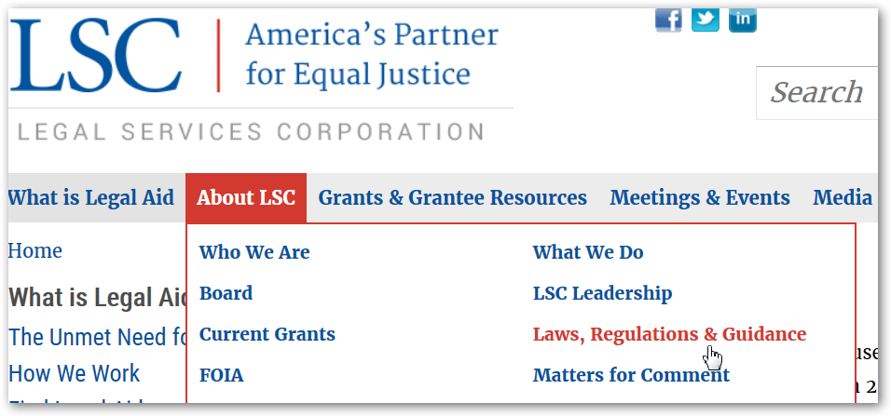
Where to Find Them
http://www.lsc.gov/about-lsc/laws-regulations-guidance
LSC Act, Appropriations, and Other Laws
LSC Regulations
External Advisory Opinions
Program Letters

Slide 108
LSC Statutes
LSC Act: 42 U.S.C. §§ 2996–2996l
Establishment of LSC
Grantee requirements
Restrictions on LSC & private funds
LSC Appropriations Riders
Since 1983, many restrictions appear in LSC’s appropriation
1996 overhaul
Incorporated in and modified by later statutes
LSC website and source book have amended appropriations

Slide 109
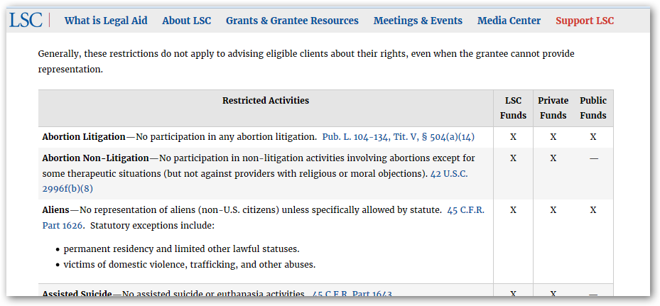
Restrictions and Funding Sources
New table showing the major restrictions and how they affect different types of funds.
In Laws, Regulations and Guidance.

Slide 110
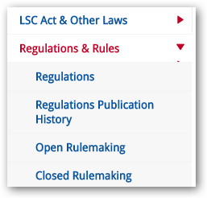
LSC Regulations
45 CFR Parts 1600 through 1644
www.lsc.gov—About – Regs & Rules
Regulations—current
Regulations Publication History
Preambles
Prior versions
Open Rulemakings
Closed Rulemakings

Slide 111
Changes to the Regulations
Part 1627—subgrants
New revised regulation effective April 1, 2017
Streamline and simplify subgrants
Part 1630 and Property Manual
Ongoing rulemaking
Other updates on LSC.gov in the Open Rulemaking

Slide 112
Grant Assurances
Contractual obligations the recipient enters into as a condition of accepting LSC grant funds
Revised for 2018 as Grant Terms and Conditions
Posted in Matters for Comment in April 2017

Slide 113
Final Questions?
Send questions through the AISitems@lsc.gov
The session will be recorded and will be posted on LSC Grants
Complete the AIS Evaluation Survey after the conference
Questions after the webinar? Email lscgrants@lsc.gov

